Slide 1
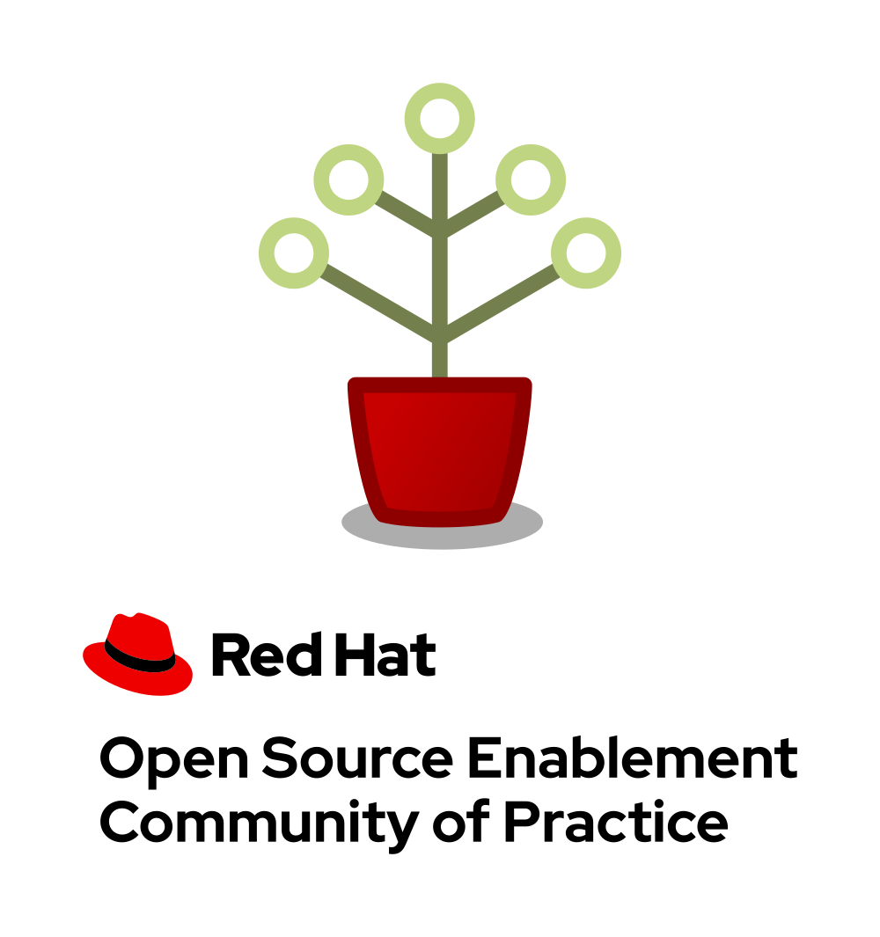

Thanks for using this resource
You've accessed presentation materials designed, developed, and maintained by the Open Source Enablement community of practice at Red Hat.
Our community welcomes all Red Hat associates wishing to learn more about the ways Red Hat can assist customers seeking to embrace open source principles and techniques. If you're interested in collaborating on resources like this one, please join us.
If you use these materials, we'd love if you'd collaborate with us to improve this (and other) resources.
Submit your feedback on this resource
Last updated: December 11, 2020
Notes:
This slide aids speaker awareness; it is not meant to be displayed during the presentation.
Watch CoP member Sayak Sarkar deliver this presentation: https://www.youtube.com/watch?v=nv2jbFQdE9s&feature=youtu.be

Slide 2
Session learning objectives
At the conclusion of this experience, participants will be able to:
Describe key differences between community participation and community leadership
Recognize challenges that new community leaders can face
Identify strategies for both increasing and sustaining community participation
Understand how to measure the success of community involvement and how to communicate that success to others
Target delivery time: 45 minutes
Suggested prerequisite courses:
Open Source Communities: What to Know Before You Go
Participating in an Open Source Community
Influencing an Open Source Community
Notes:
This slide aids speaker awareness; it is not meant to be displayed during the presentation.

Slide 3
This presentation targets an audience of advanced practitioners—learners who are already contributing to an open source community in a leadership position and want to be able to lead and grow the community more effectively.
These learners may be asking questions like:
Why do people choose to lead open source projects and communities?
What's the difference between participating in and leading a project?
How can I ensure a community grows sustainably?
How can I spread the word about this project or community?
What type of a leadership structure does a community require?
This presentation is best for audiences who want to develop a "long term vision" for their open source community but might not know how to begin.
Target audience persona: Advanced practitioner
Notes:
This slide aids speaker awareness; it is not meant to be displayed during the presentation.

Slide 4
Leading and growing an open source community
DevConf.US - 2022
Sayak Sarkar
Principal Software Engineer
Red Hat
Notes:
Hey Everyone,
It’s great to be here. I am Sayak Sarkar and I work as a Senior Software Engineer at Red Hat.
Today, I’ll be talking to you about Leading and growing an open source community.

Slide 5

What is open source project and community leadership?
Notes:
Let’s talk about what open source is and what does community leadership mean.
As contributors to a project become more familiar with how the project works, they may wish to become more active in helping the project grow. Ultimately, this means they'll be taking on more responsibilities within the project.
Today we're doing to discuss in more detail what this means—what it means, that is, to lead an open source project and / or community.
The fact is that contributing to an open source project and leading that project are two different modes of engaging with that project.
Let me explain why.

Slide 6

You are now assuming increased responsibility for an open source project's success or failure.
Notes:
As a contributor to an open source software project, your duties to the project may be more or less straightforward: fix bugs, answer questions in the project’s communication channels, etc.
When assuming a position of leadership in the project, your role becomes more comprehensive; you may drive technical direction, begin speaking with authority for the project in public venues such as conferences, initiate programs to recruit more project members, or change the project’s processes and policies.
In short: You are now assuming increased responsibility for a project's success or failure.

Slide 7

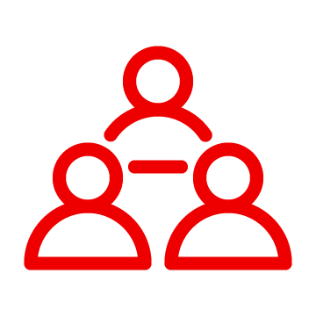

So why do it?
Organizational need
Community responsibility
Personal fulfillment
Your organization relies on the project and requires long-term sustainability.
Your organization needs to have greater influence on project roadmap & feature development.
You want to support other project leaders and create a sustainable community.
You want to help resolve conflicts or remove roadblocks.
You want to fulfill an unmet project need or support an area that needs greater involvement.
You want to advance your career by growing a skill you can't elsewhere.
You feel good about helping others.
You feel a sense of social belonging and group affiliation that motivates you help maintain the community.
Notes:
So why do that? Why take on responsibility for project and community success?
There are many reasons to take on a leadership position in your favorite open source project, ranging from the needs of your employer to your own personal joy.
As you consider taking on a leadership position in the project, take some time to think through your motivations for doing so. Having a good understanding of why you want to lead will help you choose the best places for you to apply your skills and interests in the project, be it conflict resolution or better issue triage processes to make sure that users are getting help more quickly.
It's no secret that leading an open source project has many tangible benefits when it comes to seeking employment, but many individuals choose a leadership position for the simple reason that they appreciate their social connections in the project’s community and wish to be of greater service to others in this community.

Slide 8

Our goals today.
Understand common challenges associated with expanding, maintaining, and popularizing an open source project
Explore avenues leaders can pursue to begin addressing those challenges
Identify initial steps leaders can take to achieve success
Notes:
In this presentation, we will explore leadership in open source projects, the responsibilities leaders have, the transition pathway from contributor to leader, and some ways in which excellent leaders help their projects avoid common social challenges.
Here are our goals for today:
Understand common challenges associated with expanding, maintaining, and popularizing an open source project
Explore steps new community leaders can take to begin addressing those challenges
Identify steps leaders can take to achieve project success
One additional note here: I can't guarantee you'll leave our time together today equipped with everything you could possibly need to know about being a project or community leader. Every project is different—and I don't know every bit of advice that can help you lead each of these different, individual projects. You'll need to translate this advice into your own contexts. So what we're going to do today is examine the most common avenues for meeting the challenges new leaders face, general pathways for getting started that we've found to be most fruitful.

Slide 9
Three questions
Notes:
We'll begin by stressing that anyone interested in assuming a leadership role in a community-driven project will need to begin asking three fundamental questions about that project.

Slide 10



expand the project?
How will you ...
maintain the project?
popularize the project?
Notes:
How can you...
expand the project—add contributors and increase participation in the project?
maintain the project—ensure that your growth is sustainable and that the project stays "on course" on pursuit of its mission and vision?
popularize the project—increase its visibility, make it an appealing destination for users and contributors, and keep it relevant in an ever-growing ecosystem?
The remainder of our session today will focus on each of these three questions.

Slide 11
Expand
Increasing community participation
Notes:
Let's begin with the challenge of expanding the community—increasing community participation and contribution.

Slide 12

Community challenges
Undocumented "insider information" or "folk wisdom"
Unwelcoming social dynamics
Contributor base is not diverse
Language barriers
Common challenges
Notes:
Undocumented "insider information" or "folk wisdom": Excessive (and undocumented) "insider information" or "folk wisdom" makes newcomers lacking context feel excluded.
Unwelcomed social dynamics: How welcomed do new contributors feel? Perhaps the project is not as inclusive as it could be.
Undifferentiated contributor base: Communities lacking a diverse contributor base may not seem welcoming to newcomers (especially those from underrepresented groups). We mean diversity along all axes: types of skill set, vendor diversity, number of industries represented, gender diversity, racial diversity, geographic diversity, etc. When working to grow your community, if it appears that the community is only comprised of one type of contributor, people who are not like the existing contributor base may not feel comfortable joining.
Language barriers: Communities that communicate in only one language can be intimidating for those who don't speak that language.

Slide 13
Technical challenges
Lack of clear onboarding documentation
Aligning contributors with project needs
Finding contributors with specific domain knowledge
Codebase directed at a specialized use case
Unintended use cases
Common challenges
Notes:
Lack of clear onboarding and "getting started" documentation: Lack of clear documentation on ways to get started can deter newcomers.
Aligning contributors with project needs: Aligning contributors with different skills to the most appropriate domains inside the project can be challenging.
Finding contributors with specific domain knowledge: Finding additional contributors with specific domain knowledge of specialized use cases may be difficult.
Project's codebase may be directed at a specialized use case: The project might be relatively niche; locating additional contributors who share its typical use case might be difficult.
Unintended use cases: Users might be applying a project's software to situations the project's founders had not considered, so founders might be limiting their outreach.

Slide 14

Let's talk about contributor pathways.
Notes:
Every project and community will need to address these challenges in ways that are most effective for them.
However, in general, we suggest beginning to address these challenges by examining your project's contributor pathways.

Slide 15

Opportunities for volunteers to begin lending their unique talents to an open source project are called that project's contributor pathways.
The greater the number of contributor pathways your project features, the more likely it is to recruit participants with the various skills required for the project's success.
Notes:
Opportunities for volunteers to begin lending their unique talents to an open source project are called that project's contributor pathways.
The greater the number of contributor pathways your project features, the more likely it is to recruit participants with the various skills required for the project's success.
So when you're thinking of ways to expand your project, focusing on contributor pathways is a great place to begin.

Slide 16
Typical contributor pathways
Community focus
Documenting workflow and governance processes
Onboarding and mentoring new members
Localizing content into various languages
Copywriting (for website, newsletters, blogs)
Managing social media
Organizing events
Notes:
Let's take a look at some common contributor pathways.
First, here are some pathways with a community focus:
Documenting software and processes
Onboarding and mentoring new members
Localizing content into various languages
Copywriting
Managing social media
Organizing events
Does your project currently offer new (and existing) contributors opportunities to contribute rewardingly to (or even take ownership of) work in each of these pathways?

Slide 17
Typical contributor pathways
Technical focus
Adding new features and documentation
Fixing existing bugs and triaging issues
Refactoring existing work to improve it
Performing quality assurance
Improving user interface and user experience
Release engineering
Creating and maintaining project roadmap
Code and user interface localization
Notes:
Next, let's examine some pathways with a technical focus:
Adding new features and documentation
Fixing existing bugs and triaging issues
Refactoring existing work to improve it
Performing quality assurance
Improving user interface and user experience
Release engineering
Creating and maintaining project roadmap
Code and user interface localization
Again, ask yourself: Does your project currently offer new (and existing) contributors opportunities to contribute rewardingly to (or even take ownership of) work in each of these pathways?
If not, one general way to begin expanding your project is by making concerted efforts to formalize, refine, document, and advertise these contributor pathways.

Slide 18
Maintain
Sustaining community growth
Notes:
Next, let's explore the challenges associated with maintaining a project—sustaining its growth as our (prior) expansion efforts succeed.

Slide 19
Additional infrastructure and overhead
Preserving community intimacy
Keeping a growing number of participants informed
Managing competing visions for the project
Architecting and scaling a mission and vision
Common challenges
Notes:
Additional infrastructure and overhead: Adding additional tooling and infrastructure creates additional work of coordinating participants (time otherwise spent enhancing project code), for smaller leaders may have to take on responsibilities for deploying and maintaining these new systems in addition to coordinating volunteer work.
Preserving community intimacy: Preserving the intimacy that makes a community so appealing requires more care as that community expands. Fewer people may really "know" one another; social bonds weaken.
Keeping a growing number of participants informed: Keeping all participants informed about project developments requires more time and effort if that community is large.
Managing competing visions for the project: As a community grows, competing visions for the project might create contributor tension.
Architecting and scaling a mission and vision: Projects that begin as personal hobbies don't always have explicit, clearly defined community mission and vision statements. Without these, projects won't scale well.

Slide 20

Let's talk about governance models.
Notes:
Every project and community will need to address these challenges in ways that are most effective for them.
However, in general, we suggest beginning to address these challenges by examining your project's governance models.

Slide 21
The specific combination of rules and customs that define who gets to do what—and how they are supposed to do it—is called a project's governance model.
The better you understand a project's governance model, the greater your chances of successfully helping that project evolve.
Source: A guide to open source project governance models
Notes:
The specific combination of rules and customs that define who gets to do what—and how they are supposed to do it—is called a project's governance model.
The better you understand a project's governance model, the greater your chances of successfully helping that project evolve.
So as you're looking for ways to help sustain project growth and success, we recommend beginning by examining your project's governance model(s).

Slide 22
Open source project governance
Six common models
Do-ocracy
Founder-leader
Self-appointing council/board
Electoral
Single-vendor
Foundation-backed
Source: A guide to open source project governance models
Notes:
Every project has a governance model (even the ones that say they don't!), so begin by pinning down specific details of the way the project is running today.
Here's a list of just six types of open source governance models. We don't have time to explore the individual models; however, suffice it to say here that knowing how your project is running and who is making decisions is a perfect way to begin thinking about making the project more sustainable. If the project relies on too few people, if decisions aren't being made in the most effective ways, then begin by addressing these issues.

Slide 23


Dimensions of governance
Roles
Policies & Procedures
Source: A guide to open source project governance models
Notes:
Fundamentally, however, you'll need to begin thinking about the various roles people play in the community, and the various policies and procedures that govern and direct people in those roles.
Roles are the specific functions contributors perform in and for the project. Roles have rights, responsibilities, and expectations associated with them. Make sure these are explicitly documented.
Policies and procedures are the specific rules and processes that direct people in particular roles and define the limits of acceptable behavior for the project, its best practices, etc. Make sure these are also explicitly documented.
Simply documenting roles, policies, and procedures will go a long way toward helping your project become more sustainable.

Slide 24
Popularize
Exploring recognition pathways and reward systems
Notes:
Finally, let's explore the work of popularizing a project—increasing a project's visibility, making it an appealing destination for users and contributors, and keeping it relevant in an ever-growing ecosystem.

Slide 25
Increased competition for contributors' time, attention, and energy
Community materials available in limited number of languages
Growing threat of maintainer burnout
Mismatched expectations between enterprise users and community hobbyists
Proliferation of platforms for user engagement
Common challenges
Notes:
Increased competition for contributors' time, attention, and energy: Competing for contributors' time, attention, and energy is more difficult than ever as the number of open source projects increases globally.
Community materials available in limited number of languages: Projects become popular when they connect with diverse groups of contributors. But often, project materials are only available in a limited number of languages. And if your community is not communicating in English, many people may not even be aware that it exists.
Growing threat of maintainer burnout: As a project becomes more popular, maintainers might experience burnout when trying to keep pace with it.
Mismatched expectations between enterprise users and hobbyists: Many popular open source projects are relied upon by large enterprises but maintained by volunteers, leading to a mismatch of expectations between users—who may expect enterprise grade support—and developer hobbyists who are working in their spare time. When people are using the project for enterprise work but the software is maintained by hobbyists, there can be an expectations mismatch that leads to friction in the community.
Proliferation of platforms for user engagement: Finding the best ways to reach your potential users and contributors can be time-consuming, given the many ways people choose to consume information and the. Users now expect to hear about things on Reddit and on Facebook and on Twitter and on Instagram and on TechCrunch and, and, and … so figuring out where to meet people where they are when you are but one (or a small, but mighty group) is difficult.

Slide 26

Let's talk about reward models.
Notes:
As with the other challenges we addressed so far, we could discuss many ways to begin addressing popularization challenges.
But in general, we've found that focusing on a project's reward models is a great place to begin.
So let's talk about reward models for a bit.

Slide 27
Strategies for acknowledging and honoring various contributions to an open source project are called that project's reward models.
The more reward models your project constructs, the better it can engage participants with differing motivations for contributing.
Notes:
Strategies for acknowledging and honoring various contributions to an open source project are called that project's reward models.
The more reward models your project constructs, the better it can engage participants with differing motivations for contributing.

Slide 28
Rewarding contribution
Four common models
Spotlighting community contribution
Swag
"Meet the Contributor" features
Community awards
Notes:
For example, here are four common reward models:
Spotlighting community contribution
Swag
"Meet the community" features
Community awards
Each of these models aims to connect with a certain set of motivations participants may have for contributing to a project. Everyone contributes to projects for a reason, and the most popular projects are those that make contributors feel rewarded, valued, and respected for their contributions. Generating those feelings in contributors is a great way to build your project's reputation as a rewarding, welcoming place.

Slide 29


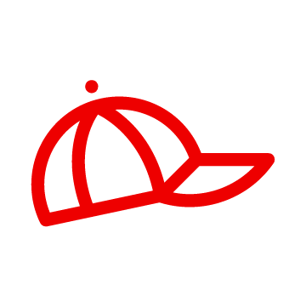

Rewarding contribution
Spotlighting community contribution
"Meet the contributor" features
Using point systems, badges, and leaderboards to chart and publicly identify contributions rewards participants by visualizing the magnitude of their contributions.
Running blog posts or video series to spotlight contributors rewards participants by helping them grow their personal brands and their professional networks.
Swag
Community awards
Giving contributors various items signifying their affiliation with the community—shirts, hats, keychains, etc.—allows participants to feel a sense of connection with the project.
Allowing community members to recognize and reward others among them helps communities develop shared identities and social bonds.
Notes:
So let's unpack this a bit more.
Spotlighting community contribution
Using point systems, badges, and leaderboards to chart and publicly identify contributions rewards participants by visualizing the magnitude of their contributions. This is a great option for connecting with people who tend to value opportunities to show off their technical prowess a bit.
"Meet the contributor" features
Running blog posts or video series to spotlight contributors rewards participants by helping them grow their personal brands and their professional networks. This is a great option for connecting with people who see community participation as an opportunity to gain visibility, maybe even find future work or employment opportunities.
Swag
Giving contributors various items signifying their affiliation with the community—shirts, hats, keychains, etc.—allows participants to feel a sense of connection with the project. This is a great option for connecting with people who see community participation as central to their identities, as a fundamental part of their identity-building work. It allows them to "show off" their connection with the community when interacting with others and makes membership in that community part of their identities.
Community awards
Allowing community members to recognize and reward others among them helps communities develop shared identities and social bonds. This is a great option for connecting with people who see community participation as a way to form bonds with others, to feel connected to a group and to feel united by a common sense of purpose. Allowing community members to reward one another allows them to continually identify and reinforce shared, communal values and identities.

Slide 30
Next steps
Gathering feedback and measuring success
Notes:
So there's an overview of three general kinds of challenges you're going to face as you assume a leadership role—expanding the community, maintaining that growth sustainably, and popularizing a project along the way.
We're almost out of time, but let's take a moment to review what might come next for you: gathering community feedback and measuring your success.

Slide 31

Gathering feedback
Open feedback forms
Fireside chats
Easily accessible, always-on forms for collecting written feedback from users and contributors
Pre-recorded, casual interviews with project maintainers and other leaders discussing project mission, vision, and strategy
Community calls
Community Q & A sessions
Live, audio-video gatherings community members can join to speak directly to project maintainers
Community-driven, "ask me anything" - style events in which community members submit and vote on questions for leaders
Notes:
First, gathering feedback.
Leading an open source project means making yourself available to address community ideas, concerns, and more. This feedback is critical to your success (and it's also a measure of your relative success), and you're positioning yourself as the party most likely to act on community feedback—so you'll need to continually collect it.
Here are some common methods:
Open feedback forms: Easily accessible, always-on forms for collecting written feedback from users and contributors
Fireside chats: Pre-recorded, casual interviews with project maintainers and other leaders discussing project mission, vision, and strategy
Community calls: Live, audio-video gatherings community members can join to speak directly to project maintainers
Community Q & A: Community-driven, "ask me anything"-style events in which community members submit and vote on questions for leaders

Slide 32

Measuring success
Communicating success with the community
How will you narrate your community's success in achieving its mission and objectives?
Communicating success with organizational stakeholders
How will you explain the value of working with your community to others in your organization?
Notes:
And then you'll need to be able to measure the success of your work with the community.
Depending on your situation, this could be important for two reasons.
Communicating success with the community: How will you narrate your community's success in achieving its mission and objectives? You'll need to be able to help your community measure its progress, chart its accomplishments, and stay focused on achievements. How will you do that?
Communicating success with organizational stakeholders: How will you explain the value of working with your community to others in your organization? If you're leading a community because a project is integral to your organization, then you'll need to be able to explain the value of your work internally, too, to organizational stakeholders.

Slide 33
Tracking technical contributions
New designs contributed
Code commits
Number of code reviews
Issues filed
Number of documents created
Pull requests to code base
Measuring success
Issues triaged
Frequency of code commits
Increases to contributor base
Frequency of code merges
Notes:
Here are just a few potential metrics you might track pertaining to technical contributions.

Slide 34
Tracking non-technical contributions
Contributor demographics
New contributors onboarded
Contributor geographic distribution
New initiatives launched
Community membership changes
Measuring success
Diversity and inclusion statistics
Views to project home page
Increases in contributor pathways
Outreach achieved
Community activity and engagement
Increased community visibility
Notes:
And here are just a few potential metrics you might track pertaining to non-technical contributions.
Gathering feedback and measuring success: Once you've determine how you're going to begin addressing leadership challenges, these will be your next steps.

Slide 35
Note to speakers
This section is under development. Future versions of this course will include case studies that illustrate the benefits of assuming a leadership role in an open source project and community.

Slide 36
Success stories
Case studies in successful open source leadership
Notes:
Taking a leadership in an open source community is definitely a challenging experience, but there are ways to meet these challenges.
As mentioned at the start of this presentation, this material is meant to identify these challenges and is not a solutions-oriented offering, but an overview of the landscape of becoming a project leader. We invite you to review some of our other materials for an in-depth exploration of how to approach and mitigate these challenges.
But before we break, let's examine just a few examples of successful leadership in several open source communities and projects.
[When materials are available mention them here and perhaps change out this divider slide for a list of links to how to overcome said challenges.]

Slide 37
Potential success stories
Angela Byron, Drupal project
Kelsey Hightower, Kubernetes project
Nithya Ruff, Comcast
Pia Mancini, Open Collective
Jessica McKellar, Python
(Someone from Blender?)
Goldman Sachs and the Symphony protocol
Hong Phuc Dang, FOSSASIA
Success stories
Notes:
Lest we leave you thinking that stepping up to lead a community project is too difficult or the challenges outweigh the rewards, let's take a moment to review success stories from projects that Red Hat support as fiscal sponsors, code contributors, project leaders, and more.
Angela Byron got her start in open source software in 2005 as a student participant in the Google Summer of Code program. She went from an inexperienced developer taking courses at a local community college to eventually becoming the senior director of product and community development for Acquia, the Drupal support company. Her engagement with the Drupal community led to her receiving an O’Reilly Open Source Award in 2008 for Best Contributor and she brought even more people into the community by authoring a book, Using Drupal, first published in 2008 and now in its second edition.

Slide 38
In summary
People choose to lead open source projects for various reasons, including organizational need, a sense of responsibility to the community, or personal and professional fulfillment.
By choosing to lead an open source project or community, you assume increased responsibility for that project's success or failure.
New community leaders face challenges related to expanding, maintaining, and popularizing their projects.
They can begin to address these challenges by examining their projects' contributor pathways, governance models, and reward models.
They will also need to determine the best ways to gather feedback from their communities, and to communicate the value and success of their work to various stakeholders.
Notes:
{Summarize the presentation's primary points for the audience. Note that these bullets reveal themselves "on click," so presenters can control the pace of the review.}

Slide 39
Thank you
Red Hat is the world’s leading provider of enterprise open source software solutions. Award-winning support, training, and consulting services make Red Hat a trusted adviser to the Fortune 500.

